Slide 1
KuBo Lab Install
Overview
CNABU
09/05/2017
V1.1

Slide 2



Kubo Deployment
K8s Cluster-2 (mykubocluster-2)
master-haproxy 10.40.207.80
master
master
etcd
etcd
etcd
worker-haproxy
worker
worker
worker
Harbor
10.40.206.145
Bosh Director
10.40.206.147
10.40.208.0/24
DVS P-G PG-COMP-VM-2
10.40.206.128/25
K8s Cluster-1 (mykubocluster-1)
DVS P-G PG-MGMT-Client
master-haproxy 10.40.207.42
master
master
etcd
etcd
etcd
worker-haproxy
worker
worker
worker
Bosh Client
10.40.206.8
10.40.206.0/25
10.40.207.0/24
DVS P-G PG-MGMT-Server
DVS P-G PG-COMP-VM-1
MGMT Cluster
COMPUTE Cluster
Physical Router

Slide 3
KuBo Deployment – High Level Steps
Deploy Bosh Client
Deploy Bosh Director
Deploy K8s Clusters

Slide 4
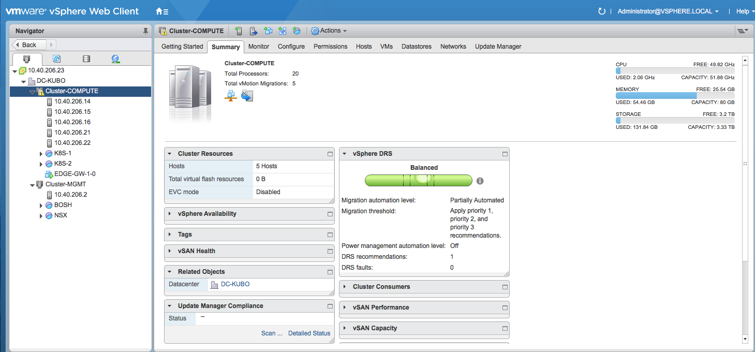
Harbor

Slide 5
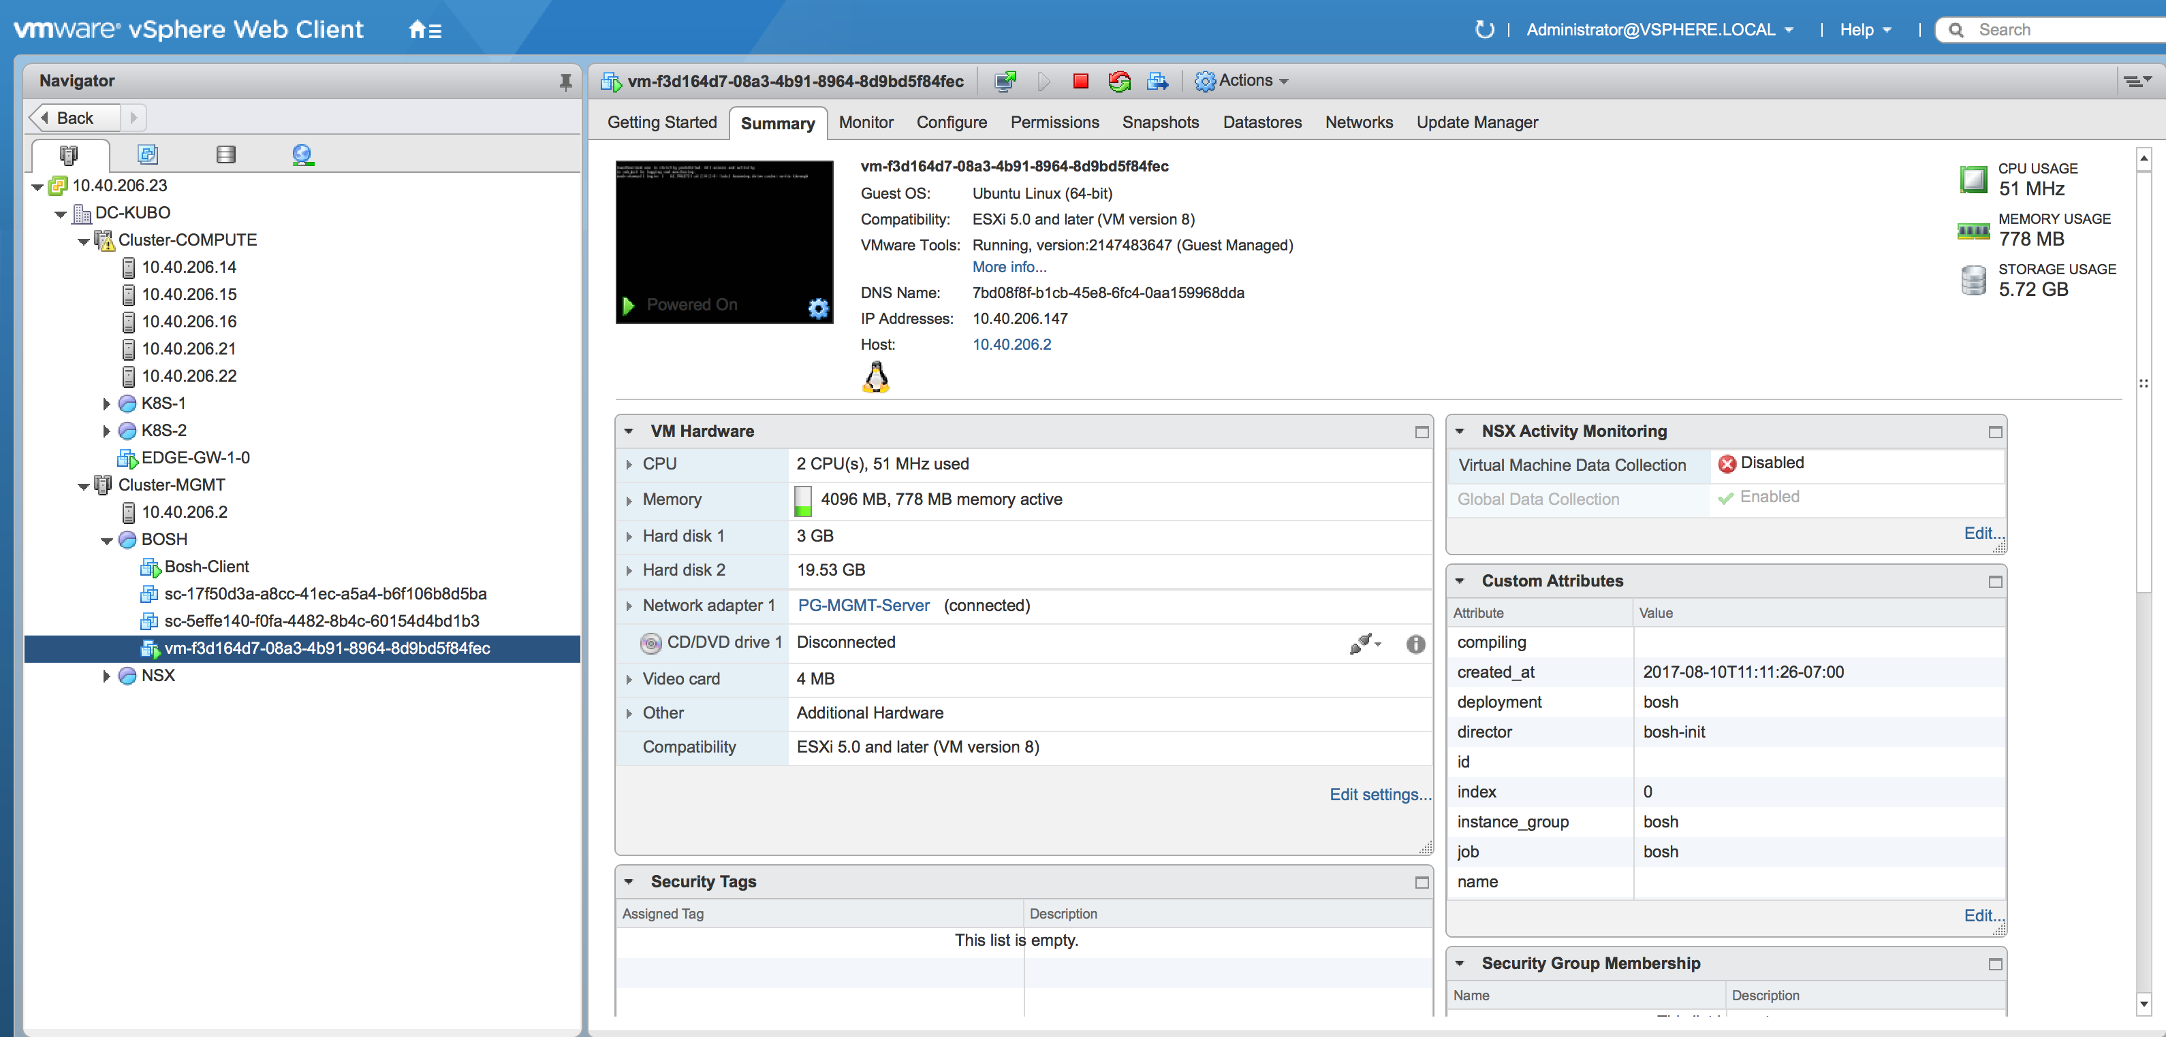
Harbor

Slide 6
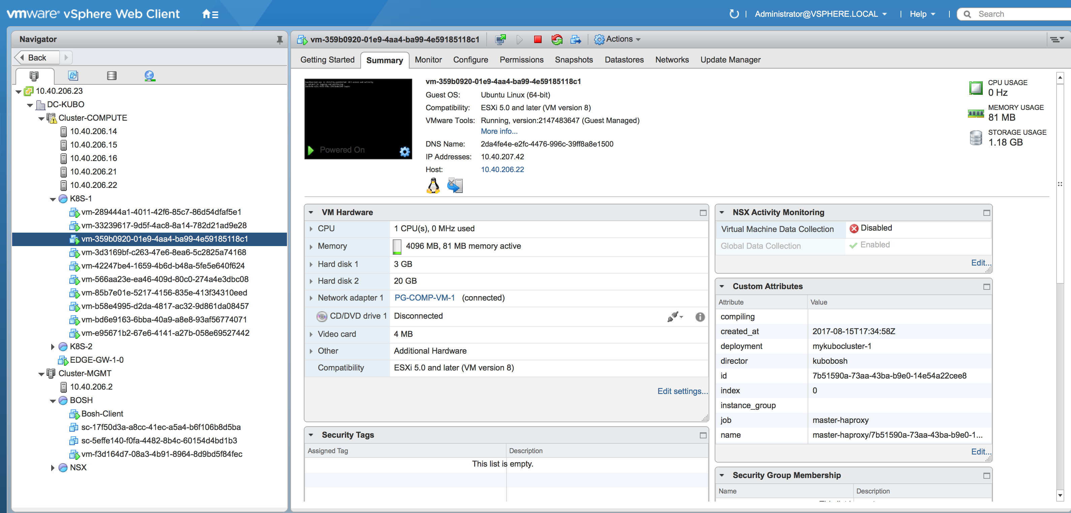

Slide 7
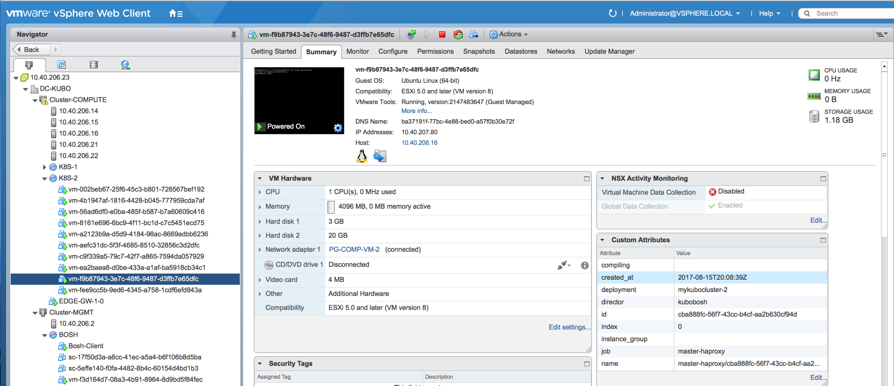

Slide 8
K8s Cluster-1 (mykubocluster-1)
master-haproxy 10.40.207.42
master
master
etcd
etcd
etcd
worker-haproxy
worker
worker
worker
Initial State:
K8s Cluster-1 (mykubocluster-1)
Final
State:
master-haproxy 10.40.207.42
master
master
etcd
etcd
etcd
worker-haproxy
worker
worker
worker
worker
worker
Additional Worker Nodes

Slide 9
Q&A

